Slide 1

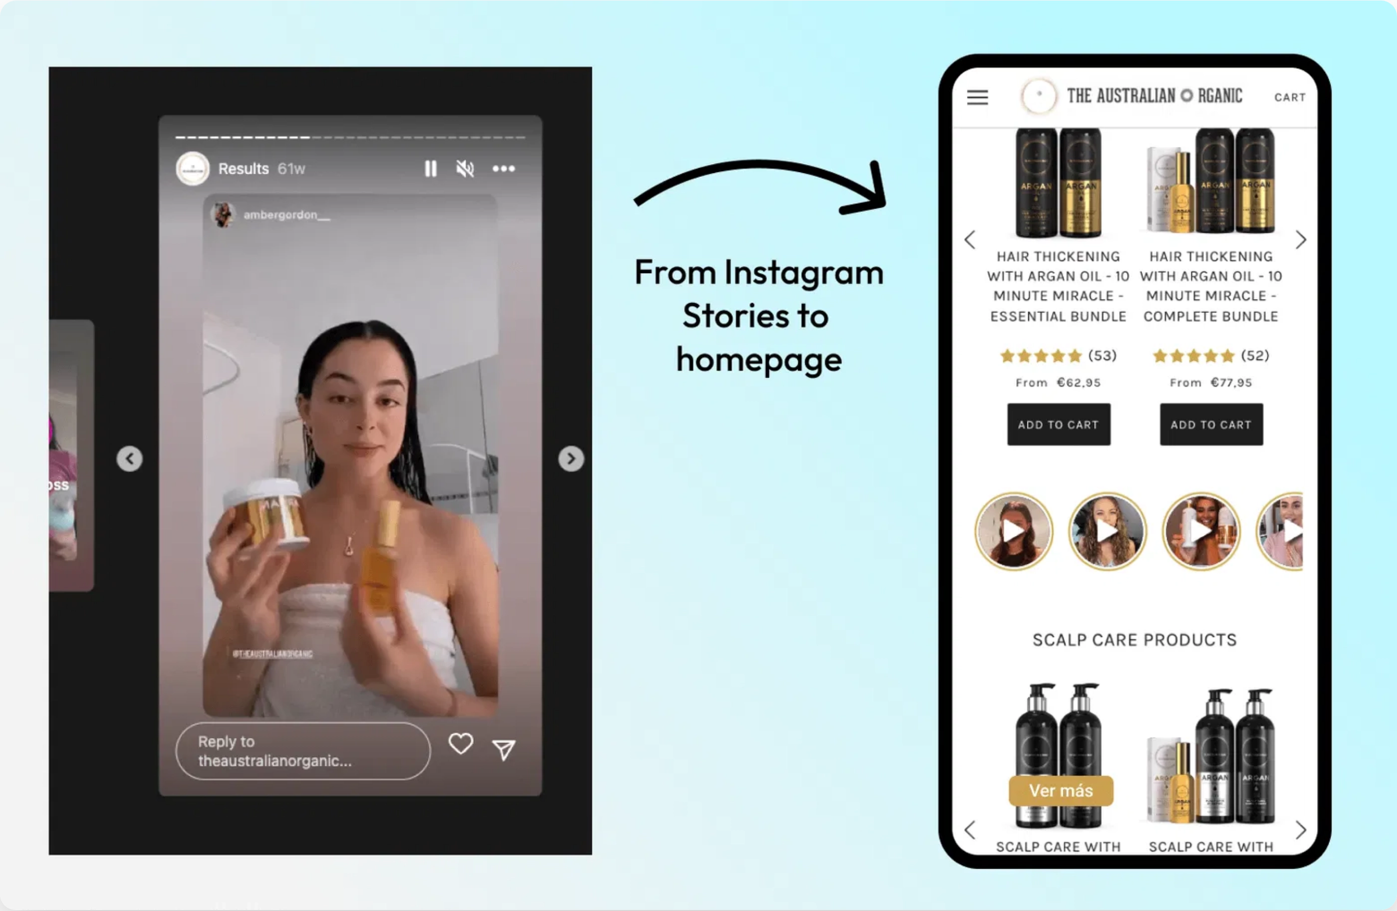
AI-Powered UGC Ads Agency
Revolutionizing Video Ads for All E-commerce Brands

Slide 2

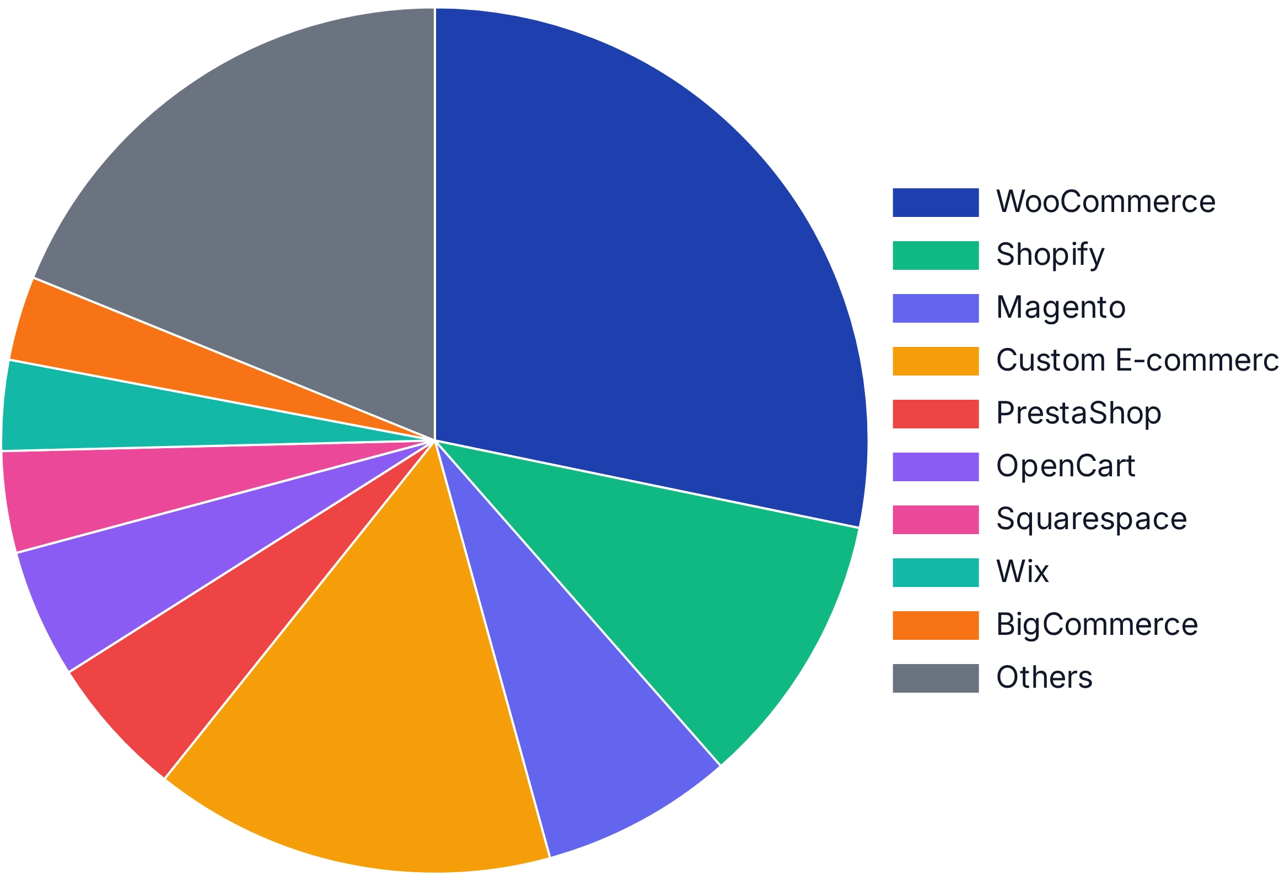

Market Opportunity
E-commerce Platform Market Share
Total Addressable Market:
Access to
100%
of the e-commerce market
across all platforms, not just Shopify's 10.3%
UGC Market Growth:
Projected to grow from $5 billion to $24 billion in
the coming years
Platform Diversity:
WooCommerce (28.24%), Shopify (10.3%), Magento
(7.18%), Custom Solutions (15%+)
Market Pain Point:
High cost of traditional UGC ($150+ per video) vs. our
solution ($50 per video at scale)

Slide 3




Service Offering
Core Package:
100 AI-generated UGC-style video ads
per month for any
AI-Generated UGC Videos
Ad Script Writing
e-commerce brand
Platform-Agnostic:
Works with all major e-commerce platforms
including Shopify, WooCommerce, Magento, and custom solutions
AI Avatar Customization
Product Integration
Multi-Category Support:
Specialized approaches for Electronics, Beauty,
Health, Outdoor, Fashion, Home, Fitness, and more
Fast Turnaround:
Complete automation reduces production time from
$5,000 per month
weeks to just 48 hours
vs. $15,000+ with traditional UGC creators

Slide 4





AI Technology Stack
Perplexity AI:
Conducts market research and pain point analysis for each
product category, identifying key customer concerns and language
patterns
Claude/GPT-4:
Generates category-specific ad scripts based on research
data, optimized for conversion and authenticity
MakeUGC.ai:
Creates high-quality UGC-style video ads with AI avatars
tailored to each product category
n8n Workflow Automation:
Orchestrates the entire process from
research to video generation, ensuring seamless integration between all
AI tools
Integrated AI workflow for automated UGC ad creation

Slide 5









Multi-Platform Support
Platform-Agnostic Approach:
Our solution works with
ALL
e-commerce
Shopify
WooCommerce
Magento
platforms, not just Shopify
10.3% Market Share
28.24% Market Share
7.18% Market Share
Expanded Market Reach:
Access to
100%
of the e-commerce market
instead of just 10.3%
Platform-Specific Optimization:
Customized ad approaches for each
platform's unique audience and features
BigCommerce
Squarespace
Wix
3.15% Market Share
3.79% Market Share
3.38% Market Share
Seamless Integration:
Works with any e-commerce setup, from
enterprise solutions to custom-built stores
PrestaShop
OpenCart
Custom
5.29% Market Share
4.81% Market Share
15%+ Market Share

Slide 6
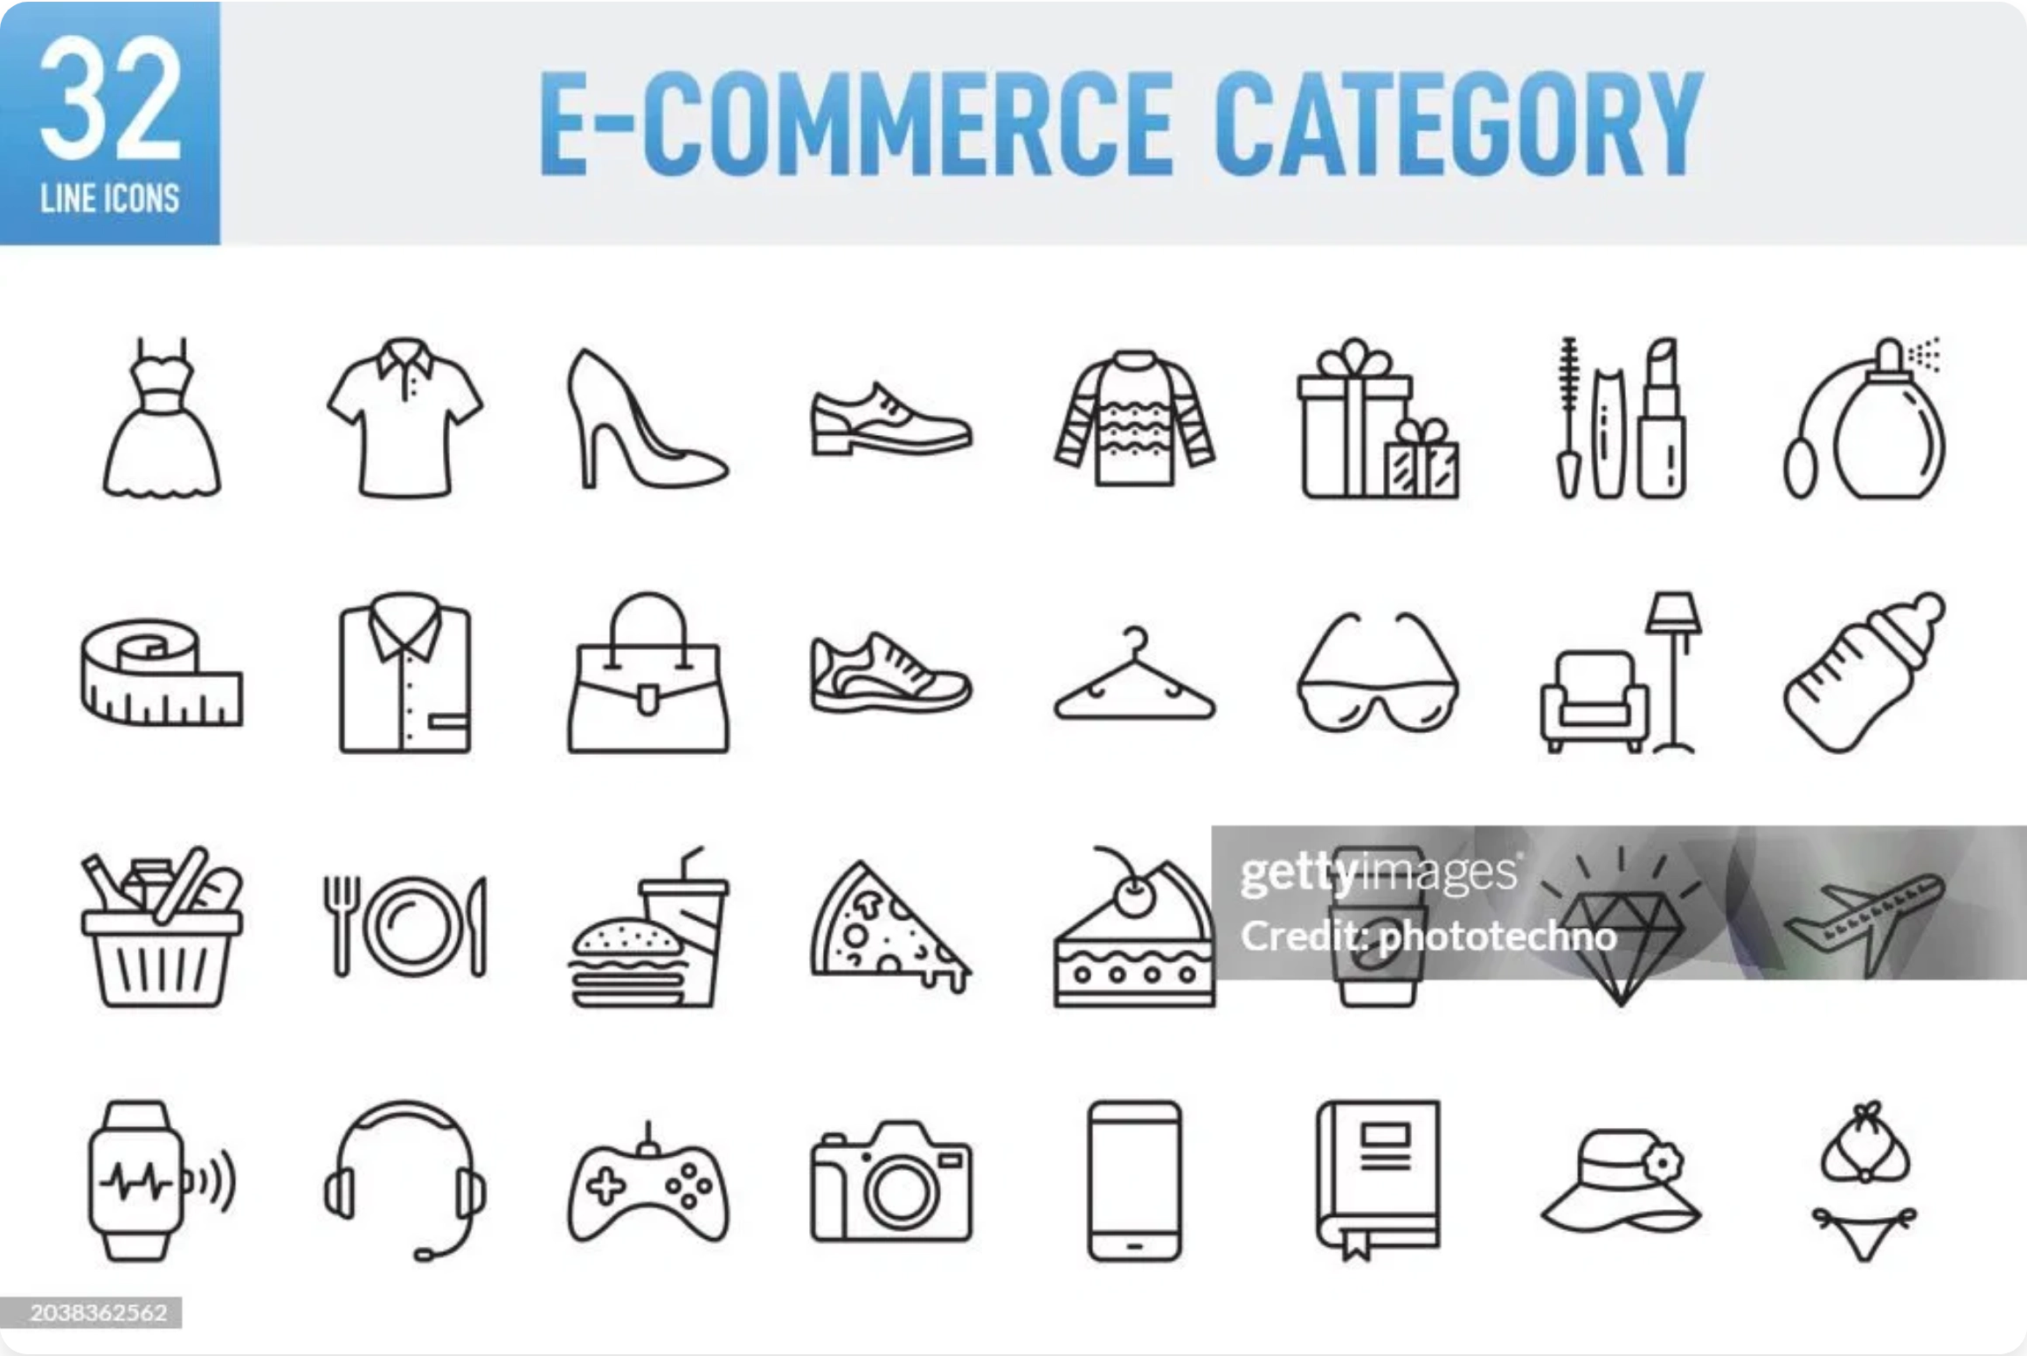








Multi-Category Support
Category-Specific Research:
Tailored pain point analysis for each
product vertical
Customized Ad Scripts:
Different tones and styles optimized for each
category
Specialized Avatars:
Category-appropriate presenters (tech reviewers,
beauty influencers, fitness trainers)
AI Category Detection:
Automatically identifies product category and
optimizes approach
Health & Supplements
Electronics
Beauty & Cosmetics
Outdoor & Sports
Fashion & Accessories
Home & Garden
Fitness & Wellness
Automotive

Slide 7

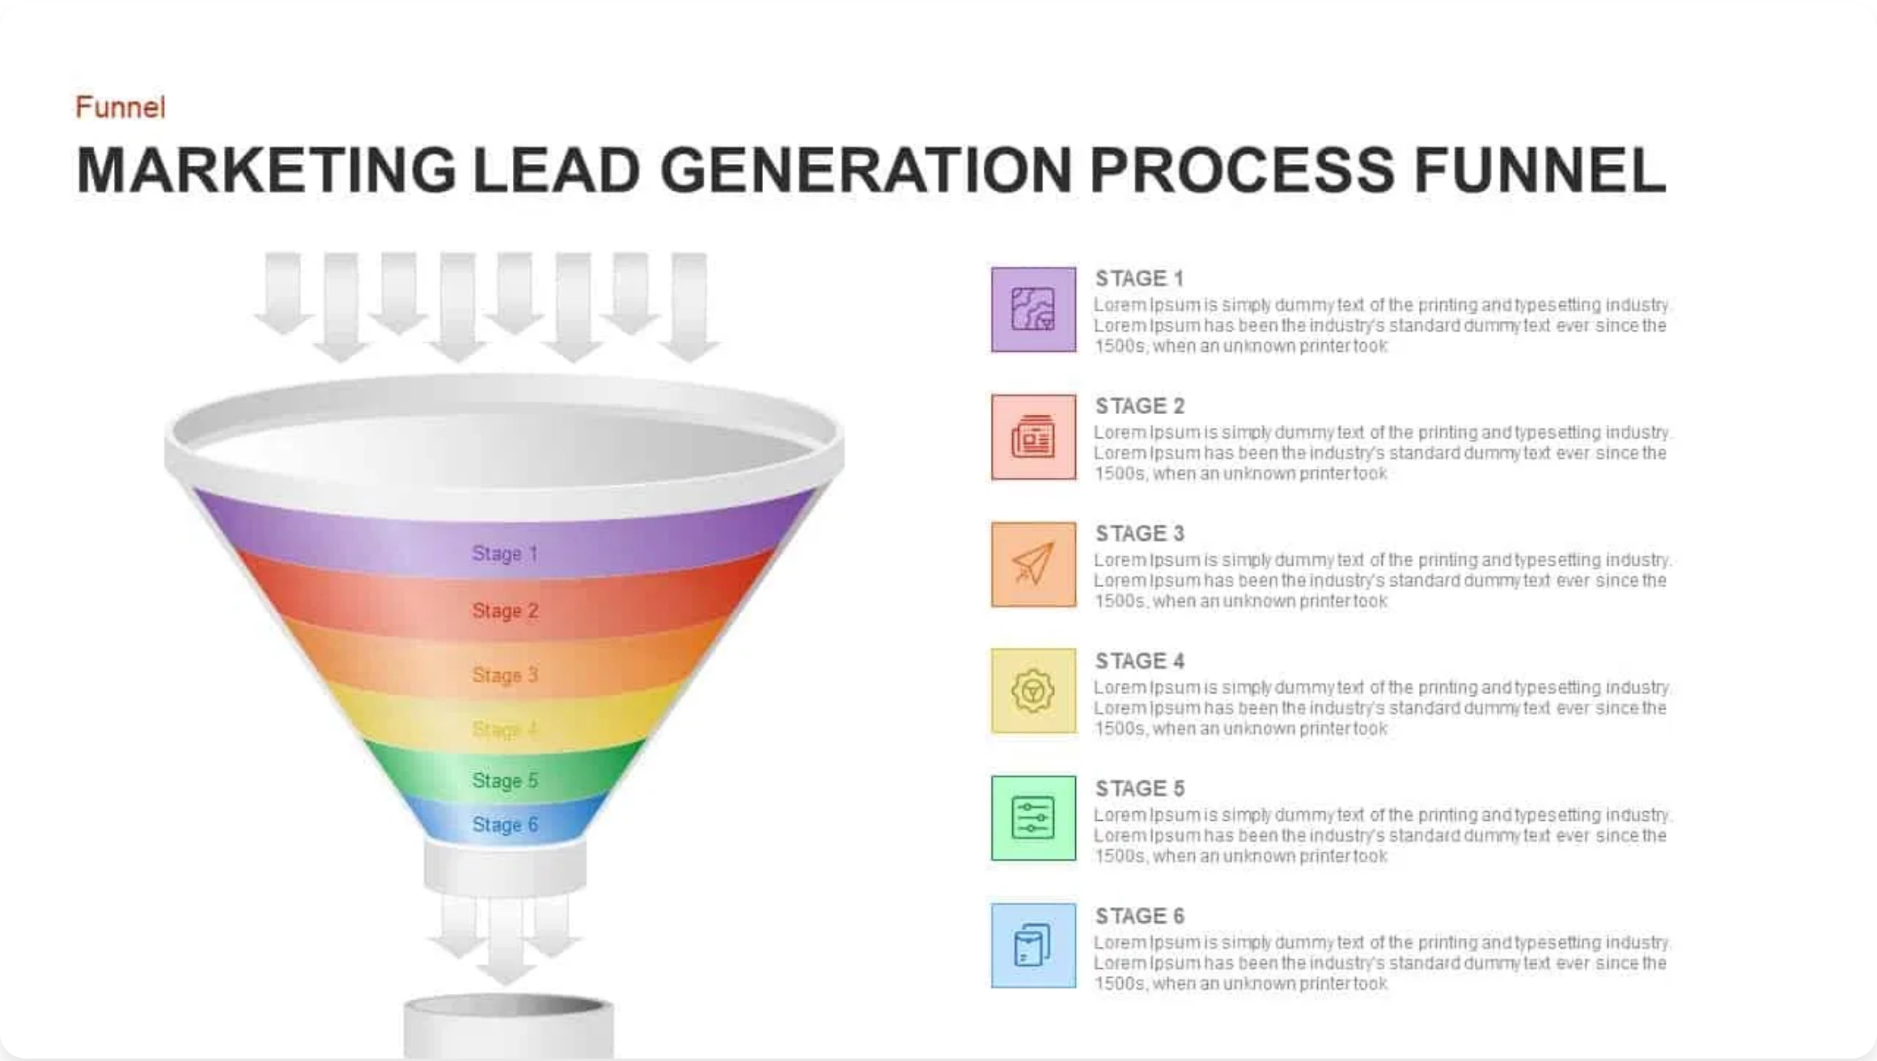




Automated Lead Generation
Lead Generation Process
Multi-Platform Discovery:
Automatically identifies potential clients
across
all e-commerce platforms
using BuiltWith technology detection
Contact Enrichment:
Uses Apollo.io to find decision-makers and their
contact information at target companies
Email Verification:
Validates all email addresses with Million Verifier to
ensure high deliverability rates
Intelligent Segmentation:
Categorizes leads by platform, product
category, company size, and monthly traffic for targeted outreach
Centralized Lead Database:
Stores all lead information in a structured
database for easy management and campaign tracking

Slide 8
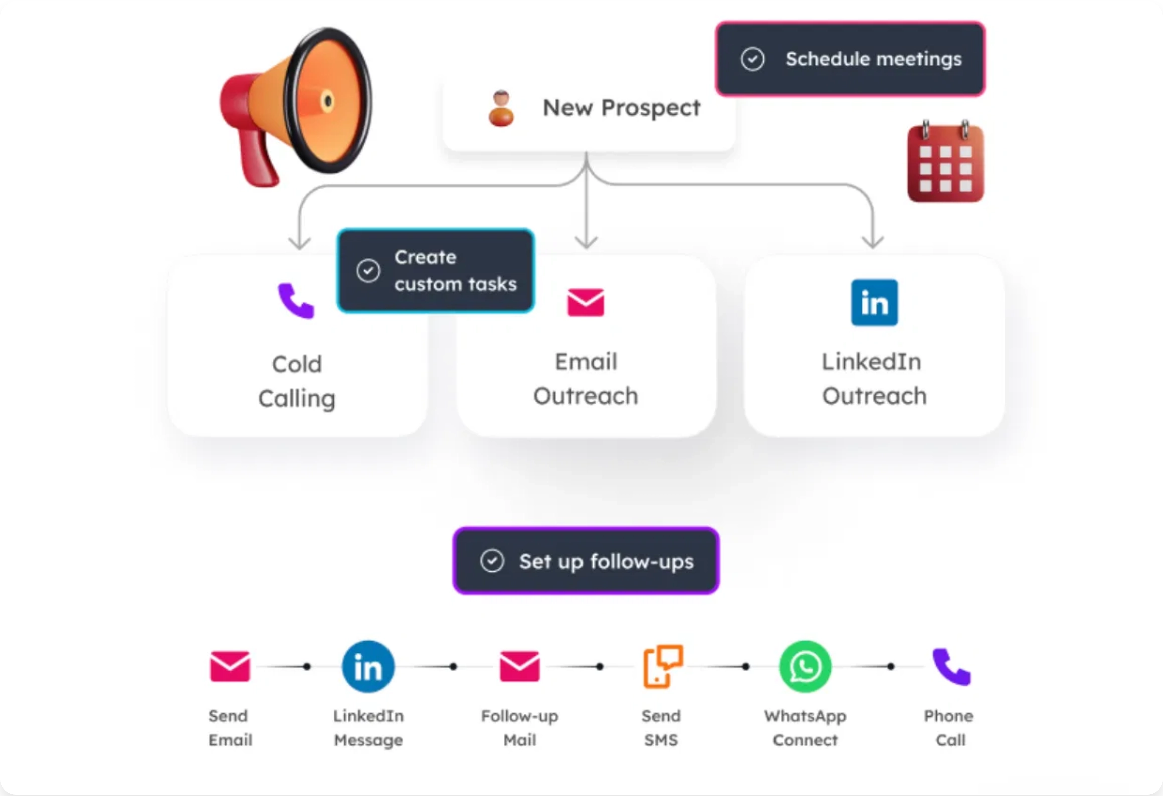








Automated Cold Outreach
Platform-Specific Email Templates:
Customized messaging for each e-
commerce platform (WooCommerce, Shopify, Magento, etc.) with
proven
conversion hooks
Multi-Channel Approach:
Coordinated outreach across email, Twitter
DMs, and LinkedIn messages for maximum response rates
Full Automation:
Entire outreach process is automated from initial
contact to follow-ups with intelligent timing and sequencing
Performance Tracking:
Comprehensive analytics on open rates,
response rates, and conversion metrics across all channels
Free Sample Offer:
Automated workflow to deliver 5 free sample ads to
interested prospects, dramatically increasing conversion rates
Email
Twitter DMs
LinkedIn
Instantly / Smartlead
InboxApp / Drippy.ai
Phantom Buster

Slide 9
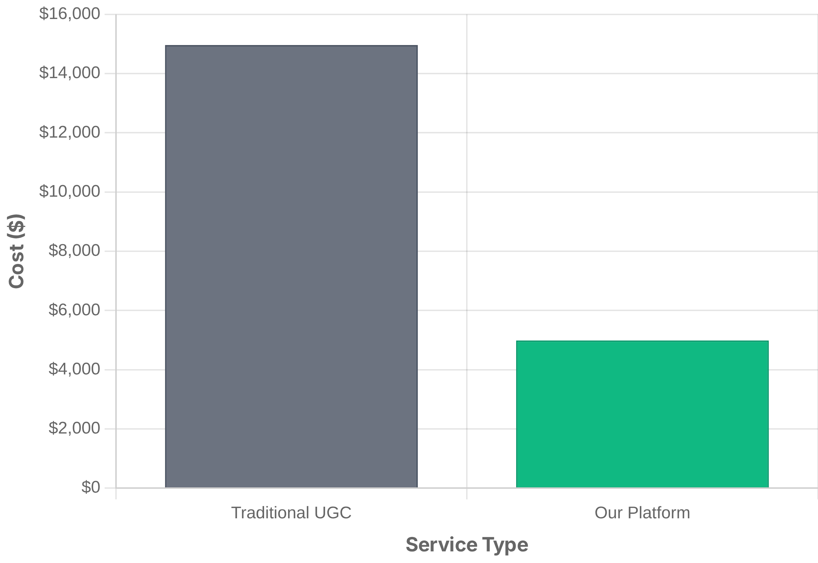
Pricing Strategy
Cost Comparison: Traditional UGC vs. Our Platform
Simple Flat-Rate Pricing:
$5,000/month
67% savings
Cost Per Video:
Only
$50 per video
compared to $150+ with traditional
UGC creators
No Hidden Fees:
All-inclusive package with research, scriptwriting, video
creation, and revisions
ROI Advantage:
Lower cost per acquisition and higher ROAS compared
to traditional UGC campaigns
Free Trial Offer:
5 free sample ads for new clients to demonstrate quality
and effectiveness

Slide 10

Next Steps
1
Schedule a Demo
See our platform in action with a personalized demonstration for your specific e-commerce category.
2
Get 5 Free Sample Ads
Experience the quality of our AI-generated UGC ads with 5 complimentary videos for your brand.
3
Onboarding & Setup
Our team will handle the entire setup process, from product research to ad creation workflow.
4
Scale Your Ad Creative
Start receiving 100 high-quality UGC-style video ads monthly for your e-commerce brand.
Get Started Today

